Slide 1
GeNDER statsitics analysis
By:
Kelwin A. Ortiz
Rhyan Vargas
Liam Cahil
Riken Maharjan

Slide 2
Table of contents
Problem
Requirements
Plan
Hadoop Tools
Sqoop
Hive
Pig
HBase
Oozie
Question #1
Assumption
Approach
Output
Question #2
Assumption
Approach
Output
Question #3
Assumption
Approach
Output
Question #4
Assumption
Approach
Output
Question #5
Assumption
Approach
Output
Improvements
OLAP Presentation

Slide 3
problem
Answer business question with the data provided.
Data provided was unorganized.
Excess data.
Multiple files.

Slide 4
Problem - requirements
Use Hadoop tools. (Sqoop, Hive, Pig, HBase, Oozie)
Create a OLTP. (MySQL)
Obtain and process useful data. (Hive, Pig)
Store data in HBase format. (HBase)
Automatize the process. (Oozie)
Use OLAP tool to create reports. (Microsoft Power BI)

Slide 5
Problem - plan
Create and transfer data to an OLTP. (MySQL, Sqoop)
Obtain and process valuable data. (Hive, Pig)
Store the data in a NoSQL table. (HBase)
Obtain results files for OLAP processing. (Microsoft Power BI)
Automate data transformation and processing. (Oozie)

Slide 6
Table of contents
Problem
Requirements
Plan
Hadoop Tools
Sqoop
Hive
Pig
HBase
Oozie
Question #1
Assumption
Approach
Output
Question #2
Assumption
Approach
Output
Question #3
Assumption
Approach
Output
Question #4
Assumption
Approach
Output
Question #5
Assumption
Approach
Output
Improvements
OLAP Presentation

Slide 7
sqoop
hbase
Data migration tool.
Data storing tool.
NoSQL database for Distributed System
Hive & pig
oozie
Data processing tool.
SQL commands.
Scripting.
Data automation tool.

Slide 8
Table of contents
Problem
Requirements
Plan
Hadoop Tools
Sqoop
Hive
Pig
HBase
Oozie
Question #1
Assumption
Approach
Output
Question #2
Assumption
Approach
Output
Question #3
Assumption
Approach
Output
Question #4
Assumption
Approach
Output
Question #5
Assumption
Approach
Output
Improvements
OLAP Presentation

Slide 9
Question #1
Identify the countries where percentage of female graduates is less than 30%.
Assumptions
Tertiary complete education for females.
Most recent years. (2010-2016)
Approach
Create a view from the master data. (MySQL)
Load to Hive and Pig this view.
Output the results to HBase.

Slide 10
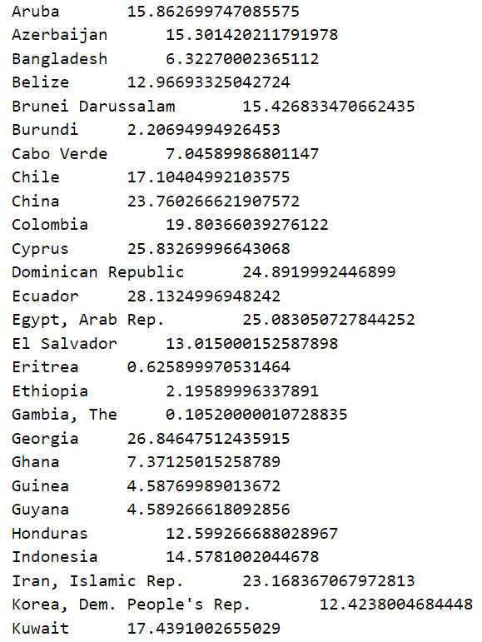
Question #1 - output

Slide 11
Table of contents
Problem
Requirements
Plan
Hadoop Tools
Sqoop
Hive
Pig
HBase
Oozie
Question #1
Assumption
Approach
Output
Question #2
Assumption
Approach
Output
Question #3
Assumption
Approach
Output
Question #4
Assumption
Approach
Output
Question #5
Assumption
Approach
Output
Improvements
OLAP Presentation

Slide 12
Question #2
List the average increase in female education in the United States from the year 2000.
Assumptions
Tertiary gross graduation female will answer the question.
Approach
The difference for each year was obtained and divided by the difference between year.
Formula : (Current Value – Past Value) / (Current Value Year – Past Value Year)
Null values considered.

Slide 13
Question #2
Methodology:
Sqoop export from HDFS to MySQL.
Create view inside MySQL.
Sqoop import the view to HDFS.
Import the data from Hive and Pig.
Create UDFs.
Export Pig result to HBase.
Create new table to export Hive data to HDFS.
Used Microsoft Power BI to do data analysis.
Result:
The average change in the female education in the United States is 0.7729%

Slide 14
Question #2 - output

Slide 15
Table of contents
Problem
Requirements
Plan
Hadoop Tools
Sqoop
Hive
Pig
HBase
Oozie
Question #1
Assumption
Approach
Output
Question #2
Assumption
Approach
Output
Question #3
Assumption
Approach
Output
Question #4
Assumption
Approach
Output
Question #5
Assumption
Approach
Output
Improvements
OLAP Presentation

Slide 16
Question #3
List the percentage of change in male employment from the year 2000.
Assumptions
Males with self employment.
The percentage of change between each year Starting from 2000.
Approach
Create a view from the master data. (MySQL)
Load to Hive and Pig this view.
Output the results to HBase.

Slide 17
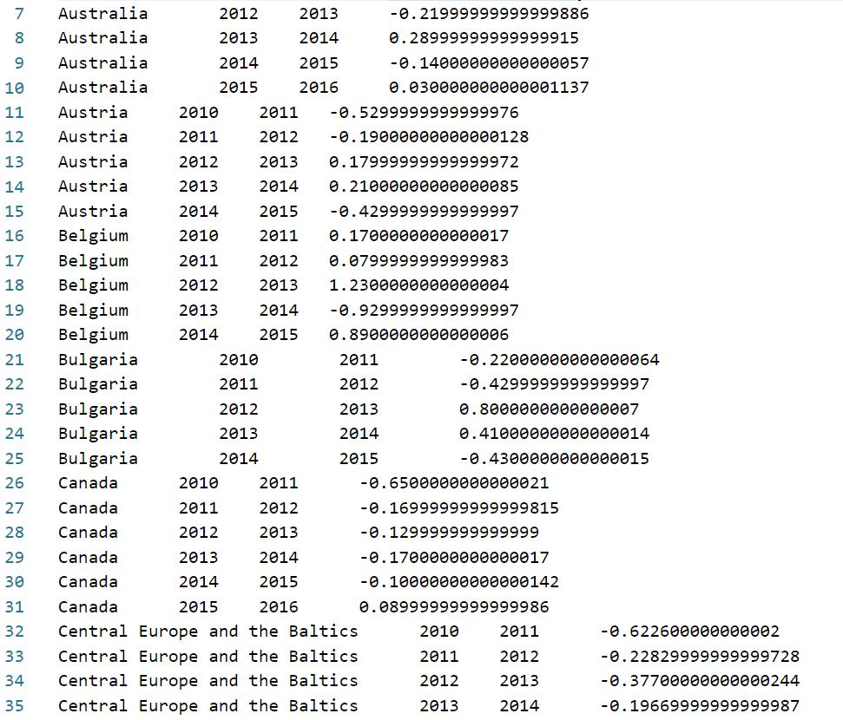
Question #3 - output

Slide 18
Table of contents
Problem
Requirements
Plan
Hadoop Tools
Sqoop
Hive
Pig
HBase
Oozie
Question #1
Assumption
Approach
Output
Question #2
Assumption
Approach
Output
Question #3
Assumption
Approach
Output
Question #4
Assumption
Approach
Output
Question #5
Assumption
Approach
Output
Improvements
OLAP Presentation

Slide 19
Question #4
List the percentage of change in female employment from the year 2000.
Assumptions
Females with self employment.
The percentage of change between each year Starting from 2000.
Approach
Create a view from the master data. (MySQL)
Load to Hive and Pig this view.
Output the results to HBase.

Slide 20
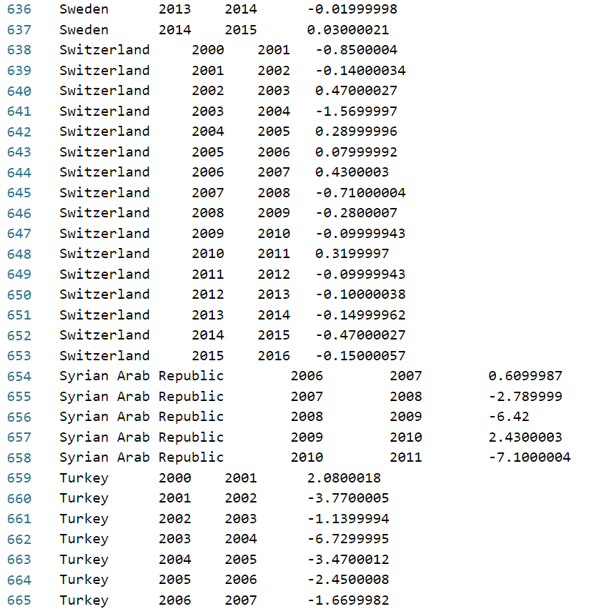
Question #4 - output

Slide 21
Table of contents
Problem
Requirements
Plan
Hadoop Tools
Sqoop
Hive
Pig
HBase
Oozie
Question #1
Assumption
Approach
Output
Question #2
Assumption
Approach
Output
Question #3
Assumption
Approach
Output
Question #4
Assumption
Approach
Output
Question #5
Assumption
Approach
Output
Improvements
OLAP Presentation

Slide 22
Question #5
What is the average percentage of female labor force in the Philippines and United States from year 2000-2016?
Assumptions
United States percentage will be higher.
Based on “Labor Force female %”.
Approach
Transposed SQL.
Load, group and calculate average in Pig.
Used hive avg() function.

Slide 23
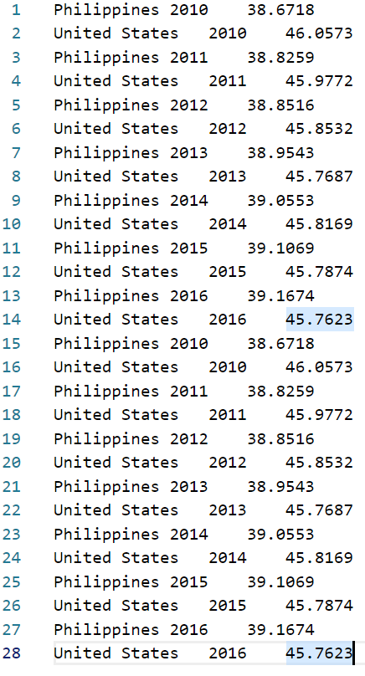

Question #5 - output

Slide 24
Table of contents
Problem
Requirements
Plan
Hadoop Tools
Sqoop
Hive
Pig
HBase
Oozie
Question #1
Assumption
Approach
Output
Question #2
Assumption
Approach
Output
Question #3
Assumption
Approach
Output
Question #4
Assumption
Approach
Output
Question #5
Assumption
Approach
Output
Improvements
OLAP Presentation

Slide 25
Improvements
Automate data cleansing process with Oozie.
Connect OLAP tool directly to destination folder. (Process output)
Design own cluster for processing.

Slide 26
Table of contents
Problem
Requirements
Plan
Hadoop Tools
Sqoop
Hive
Pig
HBase
Oozie
Question #1
Assumption
Approach
Output
Question #2
Assumption
Approach
Output
Question #3
Assumption
Approach
Output
Question #4
Assumption
Approach
Output
Question #5
Assumption
Approach
Output
Improvements
OLAP Presentation

Slide 27

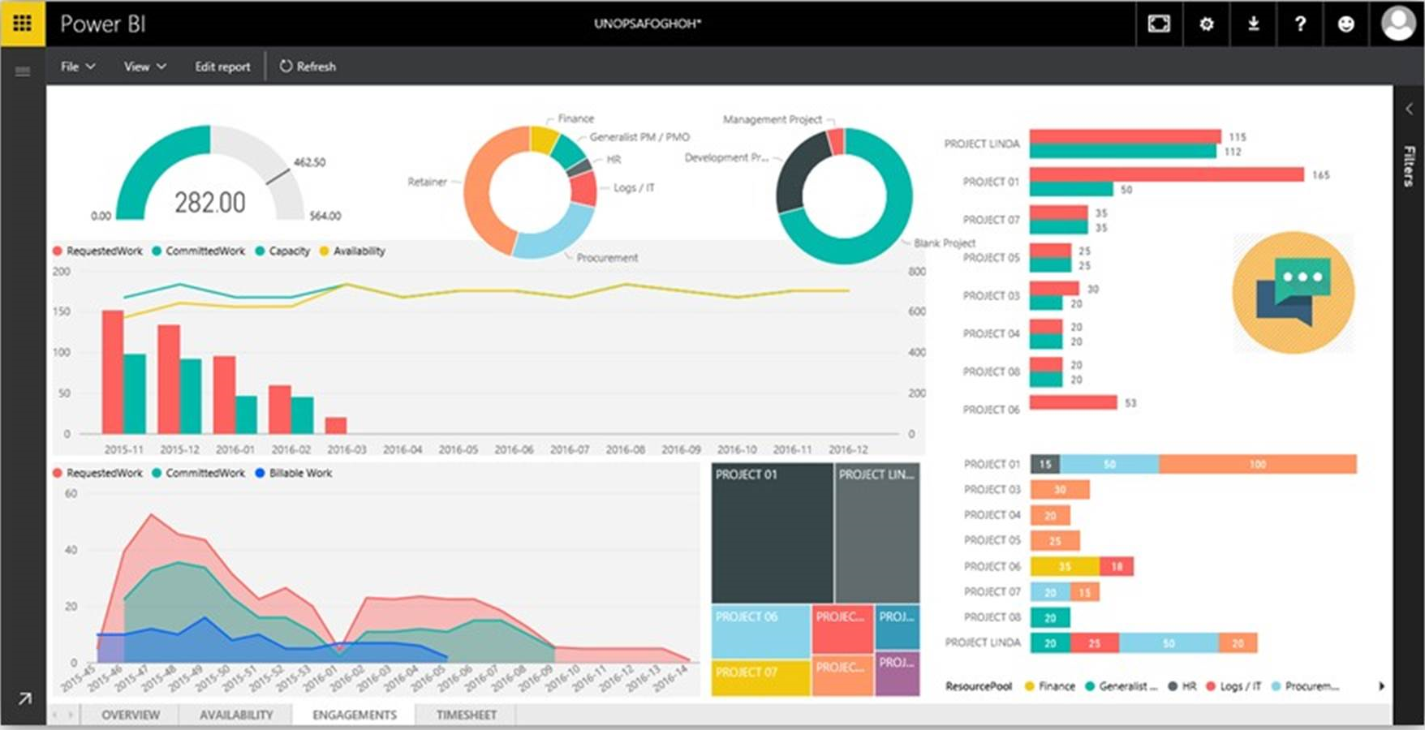
OLAP PRESENTATION – MICROSOFT POWER BI
What is Microsoft Power BI?
Power BI is a business analytic tool.
Why Power BI?
Able to connect to different multiple data sources.
Sharing.
Mobile access to dashboards and reports.
Variety of visual reports.

